Slide 1
Ontology and the lexicon
Nicola Guarino and Christopher A. Welty(2004). An Overview of OntoClean
Weber (張澄清) 2014/04/23

Slide 2
Outline
Introduction
Basic notions
Rigidity
Identity
Unity
Dependence
Constraints and Assumptions
Methodology
Example
Conclusion

Slide 3
Introduction
domain modelers can structure a taxonomy, but unable to justify themselves to others
OntoClean provided a logical basis for arguing against the most common modeling pitfalls
basic notions in OntoClean were not new
property and class are used in computer science with different meaning from the original(property in RDF)
Subsumption, properties, classes
Basic notions: essence, rigidity, identity, unity, and dependence
Adopt a first-order logic

Slide 4
Introduction
If time argument is omitted for predicate ɸ, then the predicate is assumed to be time invariant, that is
Identity relation will be assumed as time invariant: if two things are identical, they are identical forever
□ ɸ means ɸ is necessarily true, i.e., true in all possible worlds; ◊ ɸ means ɸ is possible true, i.e., true in at least one possible world
Domain of quantification will be that of possibilia → the extension of predicates will not be limited to what exits in the actual world
the examples will not be the point

Slide 5
Rigidity
Definition 1 _A rigid property is a property that is essential to all its instances, i.e, a property ɸ such that:
i.e., PERSON as rigid
Definition 2 _A non-rigid property is a property that is not essential to some of its instances, i.e. ,
i.e., having a brain in our Wizard of Oz world
Definition 3 _An anti-rigid property is a property that is not essential to all its instances, i.e. ,
i.e., STUDENT as anti-rigid

Slide 6
Rigidity
Rigid properties(+R), non-rigid properties(-R), and anti-rigid properties(~R)
Rigidity as a meta-property is not “inherited” by sub-properties, PERSON^{+R} and $∀x STUDENT\left(x\right)→PERSON\left(x\right)$
anti-rigid is “inherited”: any property subsumed by STUDENT must be anti-rigid
→anti-rigid properties cannot subsume rigid properties

Slide 7
Identity
Identity condition (IC) for an arbitrary property ɸ is usually defined as a suitable relation$ρ$ satisfying the :
When a relation $ρ$ satisfying exists for a property ɸ , we say the property ɸ carries an IC
Problem 1: distinguishing between supplying an IC and carrying an IC
→Non-rigid properties only carry their ICs, rigid properties supply

Slide 8
Identity
Problem 2: the nature of $ρ$ relation: what make it an IC, how can we index it with respect to time to account for the difference between synchronic and diachronic identity?
i.e., IC for PERSON may be the formula fingerprint(x, t)= fingerprint(y, t’)

Slide 9
Identity
An IC is necessary if it satisfies (3) and sufficient if it satisfies (4), and need not be both. This is weaker than

Slide 10
Identity
Time duration
Time interval
1:00~2:00
Next Tue.
2:00~3:00
Next Wed.

Slide 11
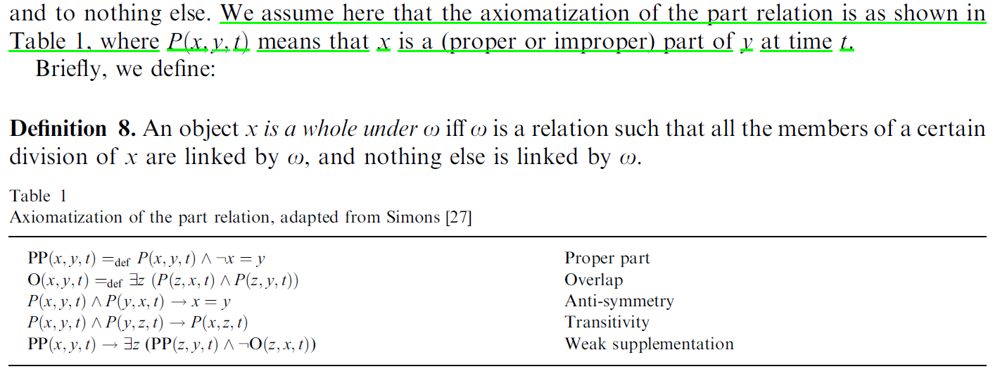
Unity

Slide 12
Unity

Slide 13
Unity

Slide 14
Dependence
An externally dependent property is +D (-D otherwise)

Slide 15
Constraints and Assumptions
Given two properties, p and q, when q subsumes p, the following constraints hold:
q is anti-rigid, then p must be anti-rigid
q carries an identity criterion, then p must carry the same criterion
q carries a unity criterion, then p must carry the same criterion
q has anti-unity, then p must also have anti-unity
q is dependent on property c, then p is dependent on property c

Slide 16
Constraints and Assumptions
Sortal Individuation: Every domain element must instantiate some property carrying an IC (+I). In this way we satisfy Quine’s dicto “No entity without identity”
Sortal Expandability: If something is an instance of different properties (for instance related to different times), then it must be also instance of a more general property carrying a criterion for its identity

Slide 17
Methodology
Assigning Meta-Properties
Analyzing Rigid Properties
The Backbone Taxonomy
Analyzing Non-rigid Properties
Phased Sortals
Roles
Attributions

Slide 18
Methodology

Slide 19
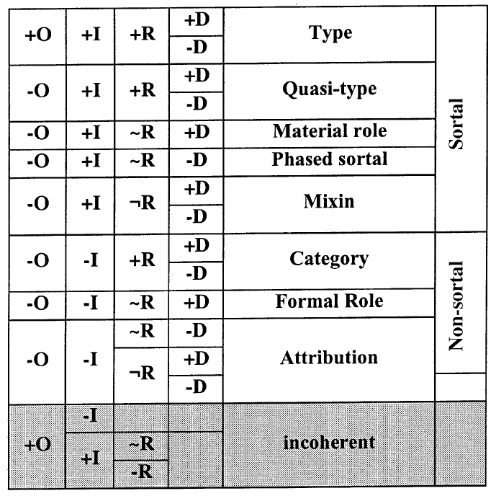
Methodology
Useful property kind
All possible combinations of meta-properties

Slide 20
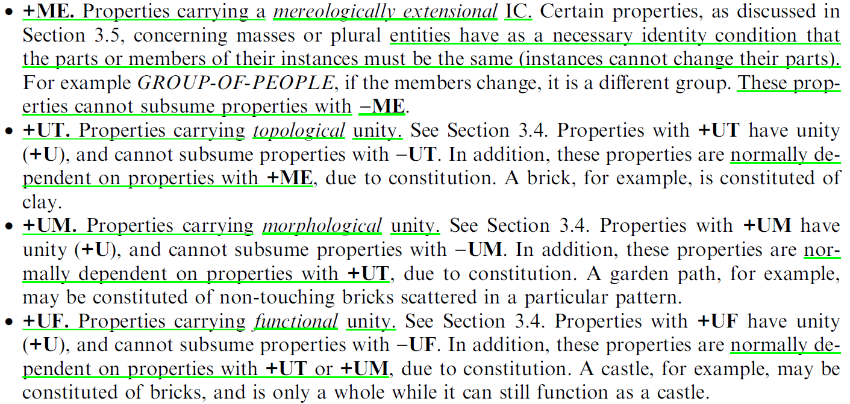
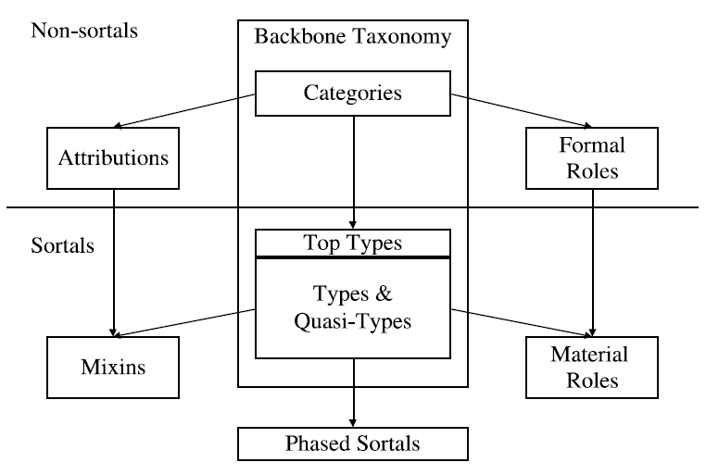
Methodology
Ontology-based modeling principles
Unity and identity assumption
Ideal taxonomy structure

Slide 21
Summary
rigid property is a property that is essential to all its instances(+R)
non-rigid property is a property that is not essential to some of its instances(-R)
anti-rigid property is a property that is not essential to all its instances
Any property carries an IC iff it is subsumed by a property supplying this IC(including the case where it supplies the IC itself)
A property ɸ supplies an IC iff (1) it is rigid; (2) there is an IC for it; (3) the same IC is not carried by all the properties subsuming ɸ. This means that, if ɸ inherits different(but compatible) ICs from multiple properties, it still counts as supplying an IC.

Slide 22
Summary
property carrying an IC is marked +I (-I otherwise); property supplying an IC is +O (-O otherwise)
Any property carrying an IC (+I) is called a sortal
A property ɸ carries a unity condition (+U) iff there exists an equivalence relation ω such that all its instances are intrinsic wholes under ω
A property has anti-unity (~U) if every instance of the property is not necessarily a whole
a property ɸ is externally dependent on a property Ψ if, for all its instances x, necessarily some instance of y must exist, which is not a part nor a constituent of x

Slide 23
Example

Slide 24
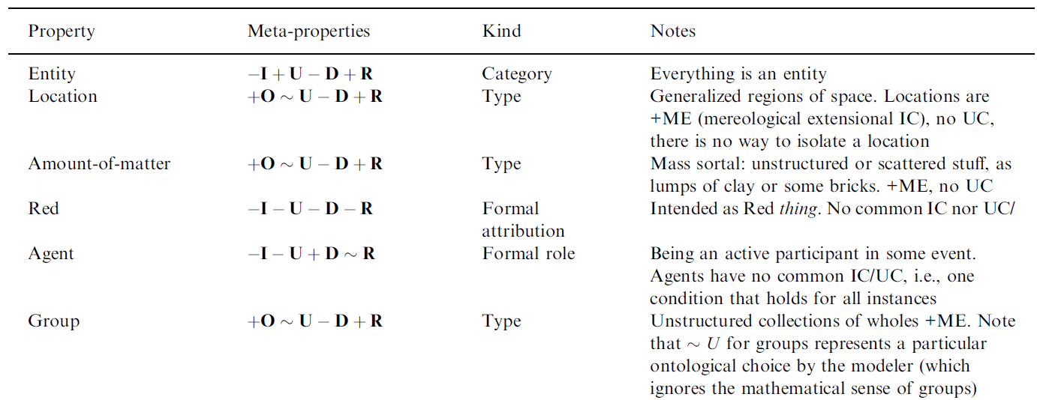
Assigning Meta-property

Slide 25
Assigning Meta-property

Slide 26
Assigning Meta-property

Slide 27
Assigning Meta-property

Slide 28
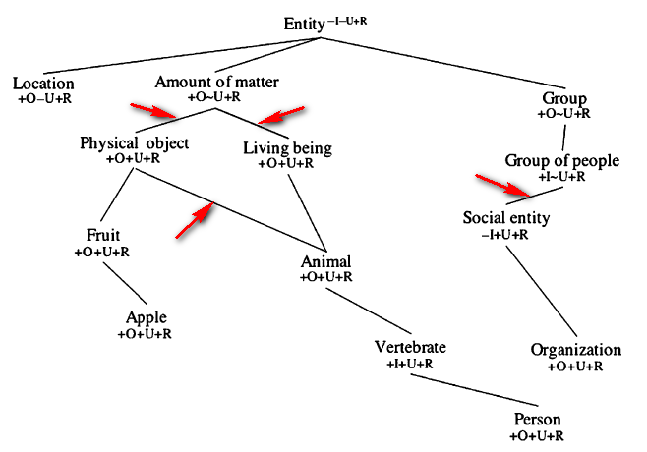
Analyzing Rigid Properties
Living beings are not amounts of matter: ~U/+U violation; IC: amounts of matter have an extensional identity
Physical objects are not amounts of matter: ~U/+U violation; Physical objects are not themselves amounts of matter, they are constituted of matter
Social entities are not groups of people: ~U/+U violation; social entity more than a group of people, must be somehow unified
Animals are not physical objects: being alive is an essential property for animals, not for physical object

Slide 29
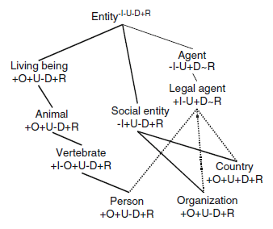
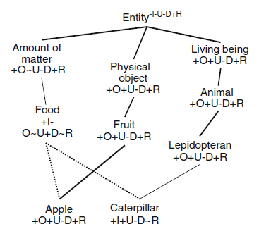
Analyzing Non-rigid Properties
Phased Sortals:
whose instances are allowed to change certain of their identity criteria during their existence
canonical example is a caterpillar
independent, anti-rigid, and supply identity criteria
Roles:
participates to a contingent event or state of affairs
anti-rigid; differently from phase sortals, do not supply identity criteria
Attributions:
the proper way to model attributions is with a simple attribute, like color, and a value, such as red

Slide 30
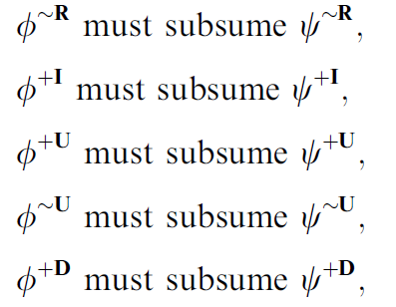
Outcome

Slide 31
Conclusion
heavier lines indicate subsumption relationships between members of the backbone taxonomy
subsumption is often used to represent things other than subsumption, can be described on language using “is a”
Sometimes “is a” is not logically consistent with the subsumption relationship

Slide 32
Reference
Welty, C. and Guarino, N. 2001. Supporting ontological analysis of taxonomic relationships. Data and Knowledge Engineering, 39(1): 51–74.

